Slide 1

Predicting Movie Success
Vikram Vasan

Slide 2

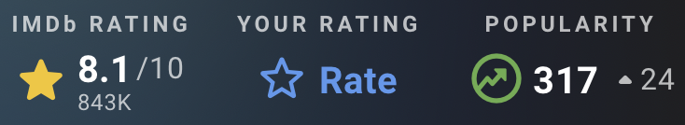


















45,466 movies from 1874 to 2017
26,024,289 ratings from 270,896 users
562
2789
15
113
4
7292
843
67
5301
92
693
488
4021
…
…
…
…
12
0
1973
45
0
901
0
658
0
Directing
Writing
Production
Crew

Slide 3
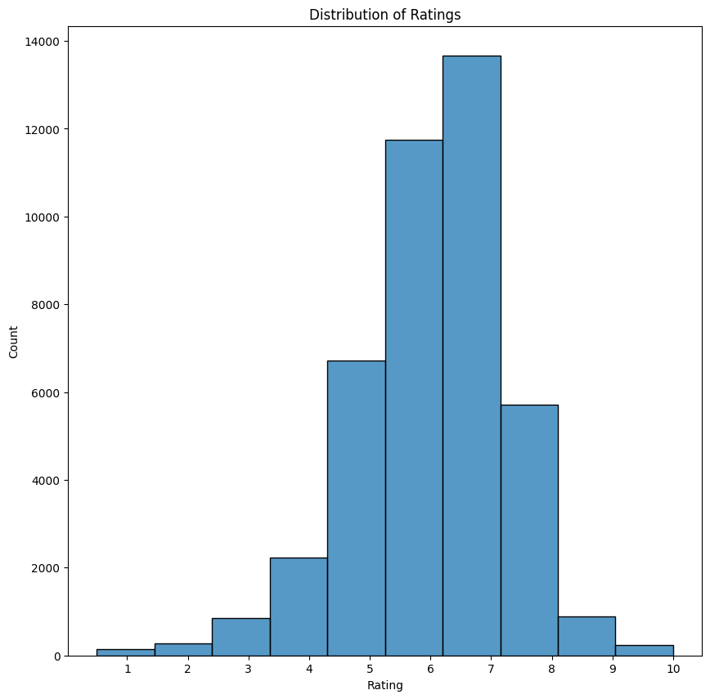
Techniques
Class Weighting
Accounts for unequal class distribution
Positional Encodings
Learns order-sensitive relationships
Attention Pooling
Focuses on the most informative pieces

Slide 4
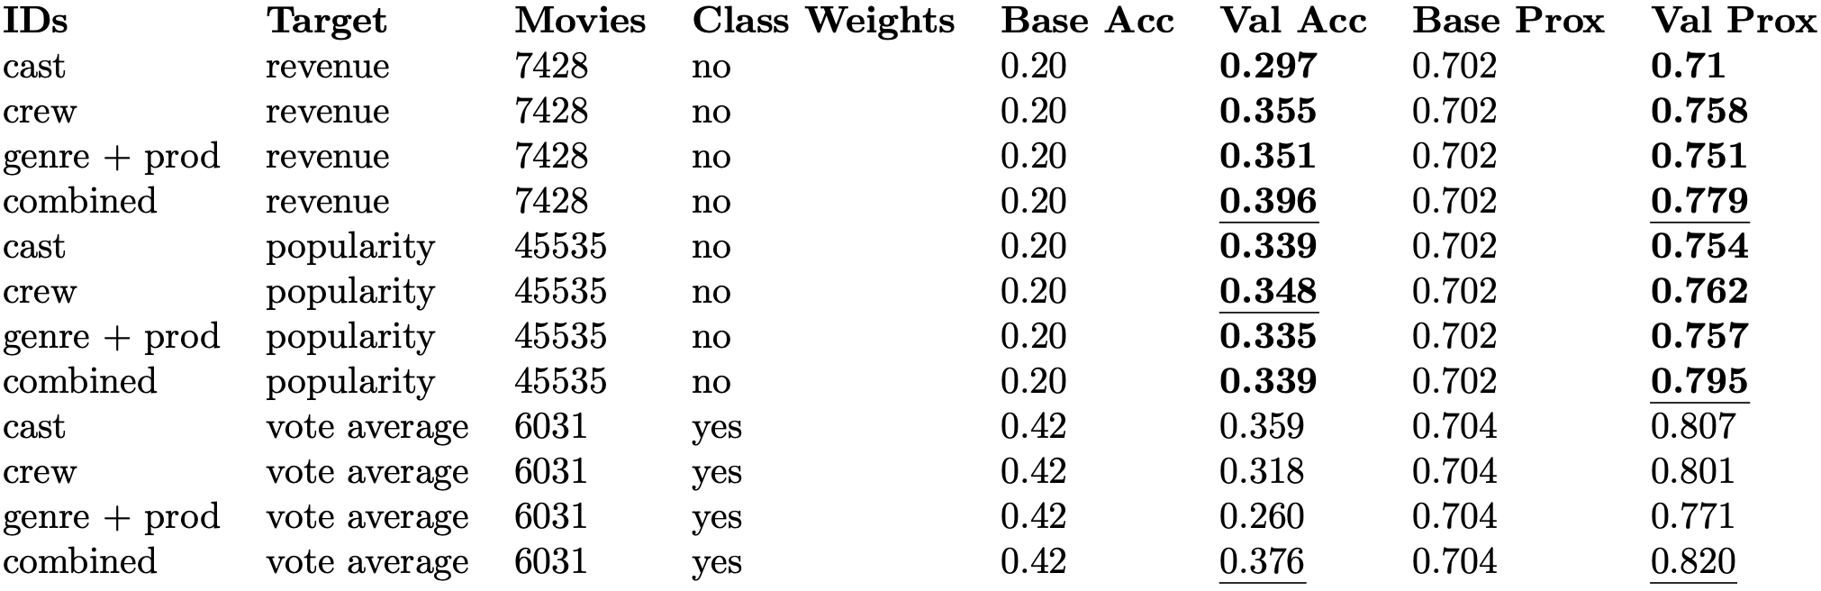
Preliminary Results
Proximity Score: captures how close predictions are to true labels by normalizing the mean absolute error relative to the label range

